Slide 1
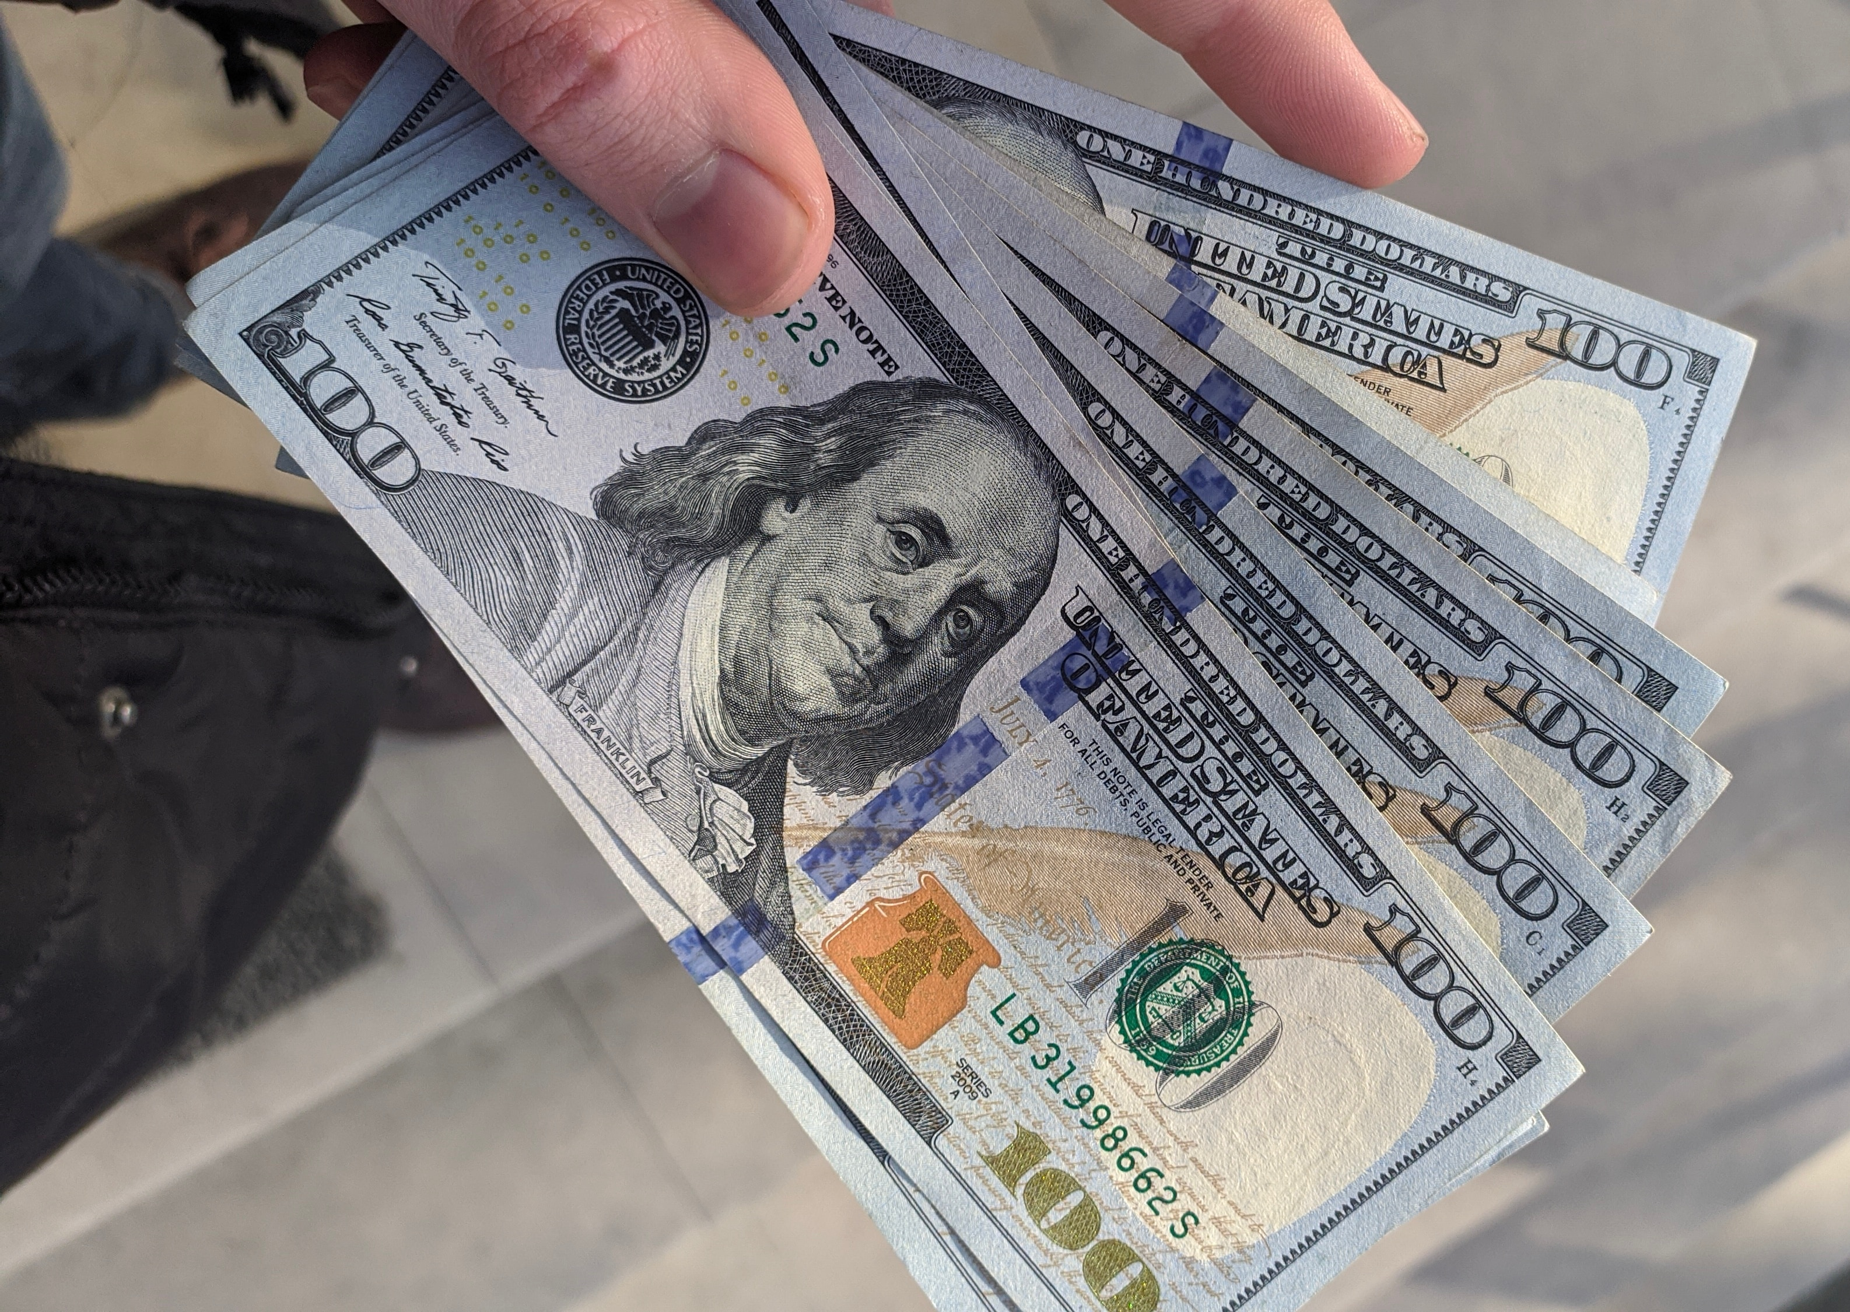
Patent Law is Expensive

Slide 2

Office Action Reporting is Inefficient

Slide 3
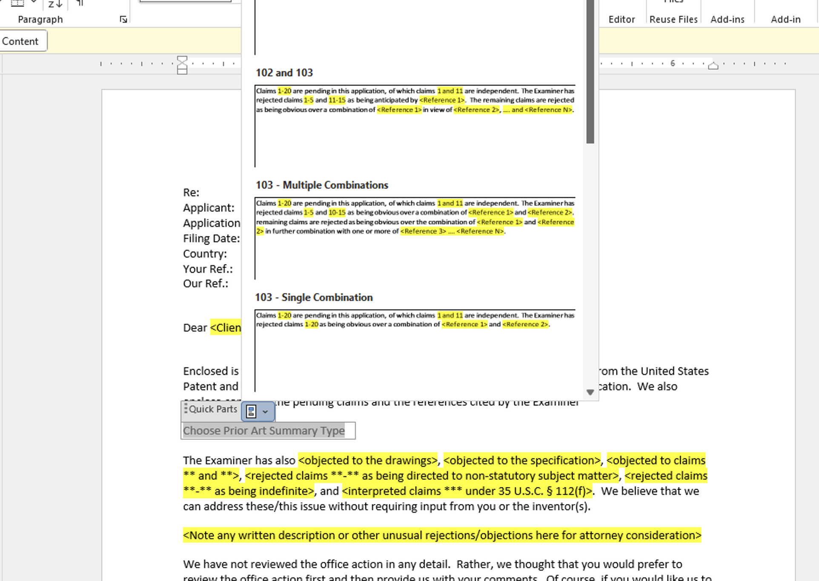
Previous Solutions Failed

Slide 4

Our New Solution

Slide 5
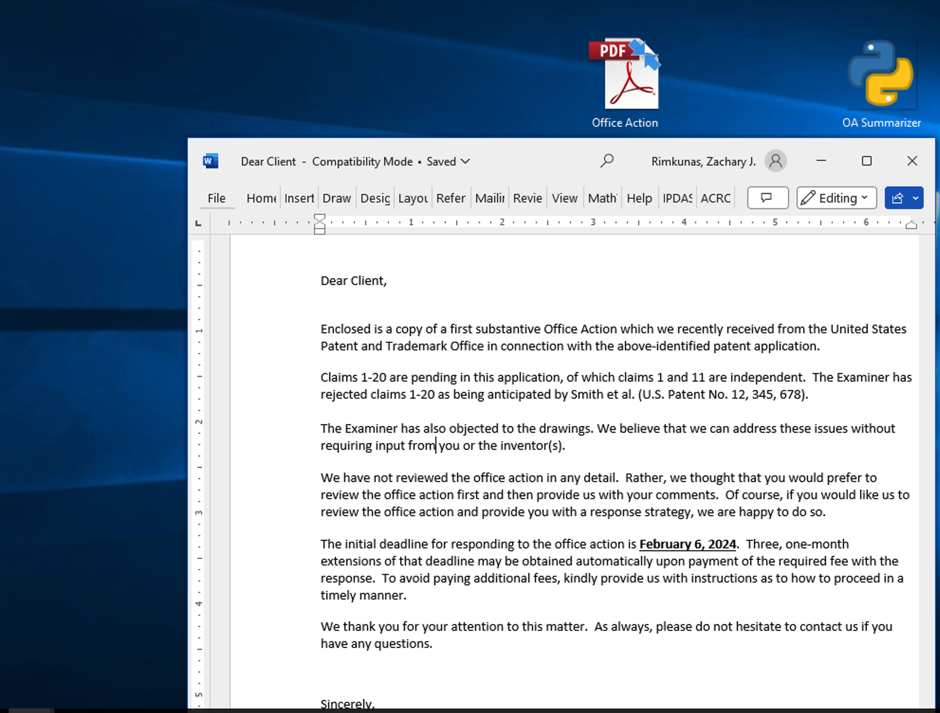
Our New Solution

Slide 6
How are We Going to Do it?

Slide 7
How are We Going to Do it?

